Slide 1
Feature Engineering
Geoff Hulten

Slide 2
Overview
Feature engineering overview
Common approaches to featurizing with text
Feature selection
Iterating and improving (and dealing with mistakes)

Slide 3
Goals of Feature Engineering
Convert ‘context’ -> input to learning algorithm.
Expose the structure of the concept to the learning algorithm.
Work well with the structure of the model the algorithm will create.
Balance number of features, complexity of concept, complexity of model, amount of data.

Slide 4
Sample from SMS Spam
SMS Message (arbitrary text) -> 5 dimensional array of binary features
1 if message is longer than 40 chars, 0 otherwise
1 if message contains a digit, 0 otherwise
1 if message contains word ‘call’, 0 otherwise
1 if message contains word ‘to’, 0 otherwise
1 if message contains word ‘your’, 0 otherwise
“SIX chances to win CASH! From 100 to 20,000 pounds txt> CSH11 and send to 87575. Cost 150p/day, 6days, 16+ TsandCs apply Reply HL 4 info”
Long? | HasDigit? | ContainsWord(Call) | ContainsWord(to) | ContainsWord(your)

Slide 5
Basic Feature Types
Binary Features
ContainsWord(call)?
IsLongSMSMessage?
Contains(*#)?
ContainsPunctuation?
Categorical Features
FirstWordPOS ->
{ Verb, Noun, Other }
MessageLength ->
{ Short, Medium, Long, VeryLong }
TokenType ->
{ Number, URL, Word, Phone#, Unknown }
GrammarAnalysis ->
{ Fragment, SimpleSentence, ComplexSentence }
Numeric Features
CountOfWord(call)
MessageLength
FirstNumberInMessage
WritingGradeLevel

Slide 6
Converting Between Feature Types
Single threshold
Numeric Feature => Binary Feature
Length of text + [ 40 ] => { 0, 1 }
Numeric Feature => Categorical Feature
Length of text + [ 20, 40 ] => { short or medium or long }
Categorical Feature => Binary Features
{ short or medium or long } => [ 1, 0, 0] or [ 0, 1, 0] or [0, 0, 1]
Binary Feature => Numeric Feature
{ 0, 1 } => { 0, 1 }
Set of thresholds
One-hot encoding
…

Slide 7
Sources of Data for Features
System State
App in foreground?
Roaming?
Sensor readings
Content Analysis
Stuff we’ve been talking about
Stuff we’re going to talk about next
User Information
Industry
Demographics
Interaction History
User’s ‘report as junk’ rate
# previous interactions with sender
# messages sent/received
Metadata
Properties of phone #s referenced
Properties of the sender
Run other models on the content
Grammar
Language
…

Slide 8
Feature Engineering for Text
Tokenizing
Bag of Words
N-grams
TF-IDF
Embeddings
NLP

Slide 9
Tokenizing
Breaking text into words
“Nah, I don't think he goes to usf” ->
[ ‘Nah,’ ‘I’, ‘don't’, ‘think’, ‘he’, ‘goes’, ‘to’, ‘usf’ ]
Dealing with punctuation
“Nah,” ->
[ ‘Nah,’ ] or [ ‘Nah’, ‘,’ ] or [ ‘Nah’ ]
“don't” ->
[ ‘don't’ ] or [ ‘don’, ‘'’, ‘t’ ] or [ ‘don’, ‘t’ ] or [ ‘do’, ‘n't’ ]
Normalizing
“Nah,” ->
[ ‘Nah,’ ] or [ ‘nah,’ ]
“1452” ->
[ ‘1452’ ] or [ <number> ]
Some tips for deciding
If you have lots of data / optimization…
Keep as much information as possible
Let the learning algorithm figure out what is important and what isn’t
If you don’t have much data / optimization...
Reduce the number of features you maintain
Normalize away irrelevant things
Focus on things relevant to the concept…
Explore data / use your intuition
Overfitting / underfitting ← much more later

Slide 10
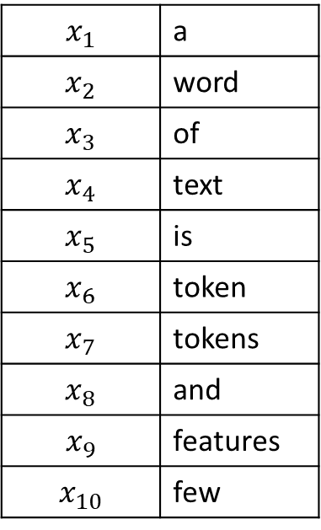
Bag of Words
One feature per unique token
Bag of words
word
of
$$x_{1}$$ | a
$$x_{2}$$ | word
$$x_{3}$$ | of
$$x_{4}$$ | text
$$x_{5}$$ | is
$$x_{6}$$ | token
$$x_{7}$$ | tokens
$$x_{8}$$ | and
$$x_{9}$$ | features
$$x_{10}$$ | few
text
a
m1:
m2:
m3:
m4:
A word of text.
A word is a token.
Tokens and features.
Few features of text.
word
is
a
a
token
features
tokens
and
few
features
of
text
Training data
Tokens
Features

Slide 11
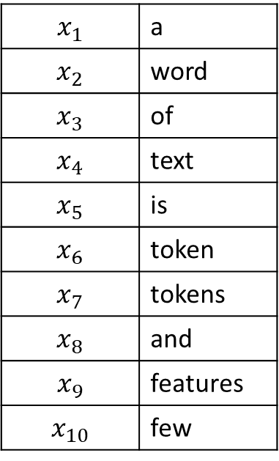
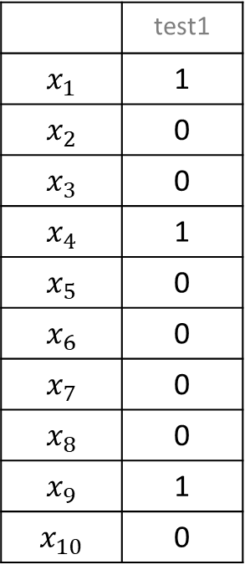
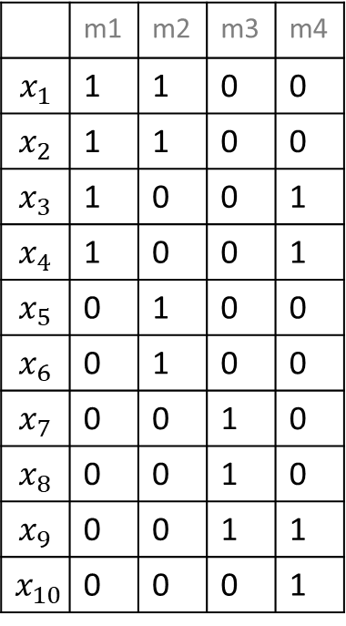
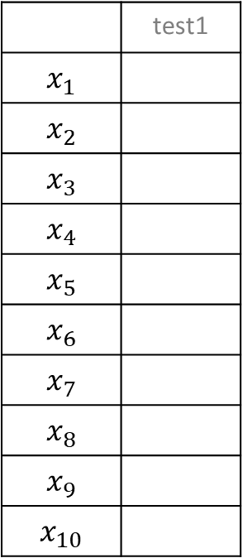
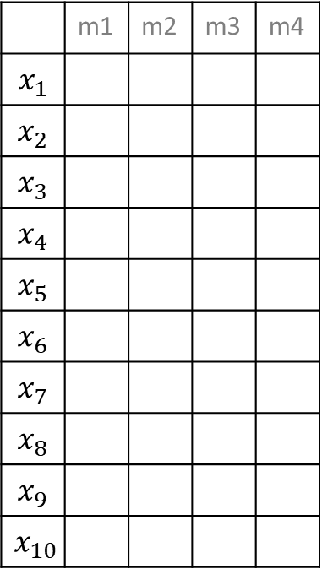
Bag of Words: Example
test1: Some features for a text example.
 | m1 | m2 | m3 | m4
$$x_{1}$$
$$x_{2}$$
$$x_{3}$$
$$x_{4}$$
$$x_{5}$$
$$x_{6}$$
$$x_{7}$$
$$x_{8}$$
$$x_{9}$$
$$x_{10}$$
 | test1
$$x_{1}$$
$$x_{2}$$
$$x_{3}$$
$$x_{4}$$
$$x_{5}$$
$$x_{6}$$
$$x_{7}$$
$$x_{8}$$
$$x_{9}$$
$$x_{10}$$
 | m1 | m2 | m3 | m4
$$x_{1}$$ | 1 | 1 | 0 | 0
$$x_{2}$$ | 1 | 1 | 0 | 0
$$x_{3}$$ | 1 | 0 | 0 | 1
$$x_{4}$$ | 1 | 0 | 0 | 1
$$x_{5}$$ | 0 | 1 | 0 | 0
$$x_{6}$$ | 0 | 1 | 0 | 0
$$x_{7}$$ | 0 | 0 | 1 | 0
$$x_{8}$$ | 0 | 0 | 1 | 0
$$x_{9}$$ | 0 | 0 | 1 | 1
$$x_{10}$$ | 0 | 0 | 0 | 1
 | test1
$$x_{1}$$ | 1
$$x_{2}$$ | 0
$$x_{3}$$ | 0
$$x_{4}$$ | 1
$$x_{5}$$ | 0
$$x_{6}$$ | 0
$$x_{7}$$ | 0
$$x_{8}$$ | 0
$$x_{9}$$ | 1
$$x_{10}$$ | 0
Out of
vocabulary
$$x_{1}$$ | a
$$x_{2}$$ | word
$$x_{3}$$ | of
$$x_{4}$$ | text
$$x_{5}$$ | is
$$x_{6}$$ | token
$$x_{7}$$ | tokens
$$x_{8}$$ | and
$$x_{9}$$ | features
$$x_{10}$$ | few
m1:
m2:
m3:
m4:
A word of text.
A word is a token.
Tokens and features.
Few features of text.
Selected Features
Training X
Test X
Use bag of words when you have a lot of data, can use many features

Slide 12
N-Grams: Tokens
Instead of using single tokens as features, use series of N tokens
“down the bank” vs “from the bank”
Message 1: “Nah I don't think he goes to usf”
Message 2: “Text FA to 87121 to receive entry”
Nah I | I don’t | don’t think | think he | he goes | goes to | to usf | … | Text FA | FA to | 87121 to | To receive | receive entry
0 | 0 | 0 | 0 | 0 | 0 | 0 | … | 1 | 1 | 1 | 1 | 1
Message 2:
Use when you have a LOT of data, can use MANY features

Slide 13
N-Grams: Characters
Instead of using series of tokens, use series of characters
Message 1: “Nah I don't think he goes to usf”
Message 2: “Text FA to 87121 to receive entry”
Na | ah | h <space> | <space> I | I <space> | <space> d | do | … | <space> e | en | nt | tr | ry
0 | 0 | 0 | 0 | 0 | 0 | 0 | … | 1 | 1 | 1 | 1 | 1
Message 2:
Helps with out of dictionary words & spelling errors
Fixed number of features for given N (but can be very large)

Slide 14
TF-IDF Term Frequency – Inverse Document Frequency
Instead of using binary: ContainsWord(<term>)
Use numeric importance score TF-IDF:
TermFrequency(<term>, <document>) =
% of the words in <document> that are <term>
InverseDocumentFrequency(<term>, <documents>) =
log ( # documents / # documents that contain <term> )
Importance to
Document
Novelty across
corpus
Words that occur in many documents have low score ($x_{i}$)
Message 1: “Nah I don't think he goes to usf”
Message 2: “Text FA to 87121 to receive entry”
 | Nah | I | don't | think | he | goes | to | usf | Text | FA | 87121 | receive | entry
BOW | 0 | 0 | 0 | 0 | 0 | 0 | 1 | 0 | 1 | 1 | 1 | 1 | 1
TF-IDF | 0 | 0 | 0 | 0 | 0 | 0 | 0 | 0 | .099 | .099 | .099 | .099 | .099
Message 2:

Slide 15
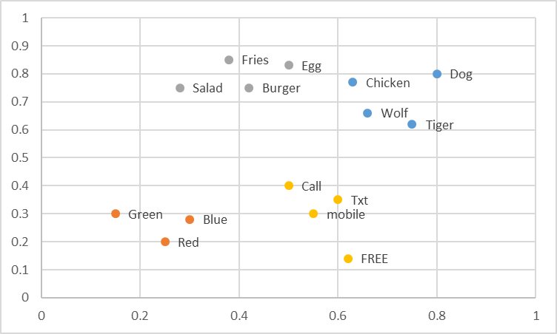
Embeddings -- Word2Vec and FastText
Word -> Coordinate in N dimension
Regions of space contain similar concepts
Creating Features Options:
Average vector across words
Count in specific regions
Commonly used with neural networks
Replaces words with their ‘meanings’ – sparse -> dense representation

Slide 16
Normalization (Numeric => Better Numeric)
Helps make model’s job easier
No need to learn what is ‘big’ or ‘small’ for the feature
Some model types benefit more than others
To use in practice:
Estimate mean/stdev on training data
Apply normalization using those parameters to validation /train
Raw X
Normalize
Mean
Normalize
Variance
36
74
22
81
105
113
77
91
-38.875
-0.875
-52.875
6.125
30.125
38.125
2.125
16.125
-1.31696
-0.02964
-1.79123
0.207495
1.020536
1.29155
0.071988
0.546262
Subtract
Mean
Divide by
Stdev
Mean: 74.875
Mean: 0
Mean: 0
Std: 29.5188
Std: 1

Slide 17
Feature Selection
Which features to use?
How many features to use?
Approaches:
Frequency
Mutual Information
Accuracy

Slide 18
Feature Selection: Frequency
Take top N most common features in the training set
Feature | Count
to | 1745
you | 1526
I | 1369
a | 1337
the | 1007
and | 758
in | 400
… | …

Slide 19
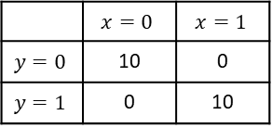
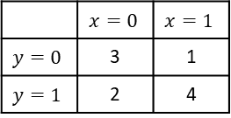

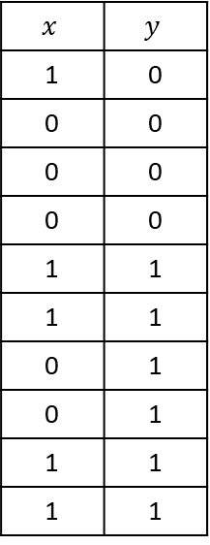
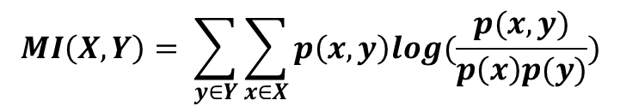


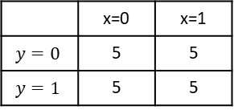
Feature Selection: Mutual Information
Take N that contain most information about target on the training set
$$MI\left(X,Y\right)= \sum_{y∈Y}{\sum_{x∈X}{p\left(x,y\right)log(\frac{p(x,y)}{p\left(x\right)p(y)})}}$$
$$x$$ | $$y$$
1 | 0
0 | 0
0 | 0
0 | 0
1 | 1
1 | 1
0 | 1
0 | 1
1 | 1
1 | 1
$$p\left(x=0,y=0\right)log\left(\frac{p\left(x=0,y=0\right)}{p\left(x=0\right)p\left(y=0\right)}\right)$$
$$= .3 ∗log\left(\frac{.3}{.5 ∗ .4}\right)=0.122$$
 | $$x=0$$ | $$x=1$$
$$y=0$$ | 3 | 1
$$y=1$$ | 2 | 4
Sum over all combinations: MI = 0.086
Contingency
Table
 | $$x=0$$ | $$x=1$$
$$y=0$$ | 10 | 0
$$y=1$$ | 0 | 10
Perfect predictor → high MI
 | x=0 | x=1
$$y=0$$ | 5 | 5
$$y=1$$ | 5 | 5
Training Data
No Information → 0 MI
Additive Smoothing to avoid 0s: $P\left(∗\right)= \frac{Obs\left(∗\right)+1}{N+2}$
Notes:
Log(1) = 0
Log(2) ~ .3

Slide 20
Feature Selection: Accuracy (wrapper)
Take N that improve accuracy most on hold out data
Greedy search, adding or removing features
From baseline, try adding (removing) each candidate
Build a model
Evaluate on hold out data
Add (remove) the best
Repeat till you get to N
Remove | Accuracy
<None> | 88.2%
claim | 82.1%
FREE | 86.5%
or | 87.8%
to | 89.8%
… | …

Slide 21
Important note about feature selection
Do not use validation (or test) data when doing feature selection
Use train data only to select features
Then apply the selected features to the validation (or test) data

Slide 22
Simple Feature Engineering Pattern
Input for machine learning model at runtime
TrainingContextX
runtimeContextX
FeaturizeTraining
Featurize Runtime
runtimeX
TrainingY
Featurize Data
Selected words / n-grams and their feature indexes
TF-IDF weights to use for each word
Raw data to featurize and do feature selection with
Info needed to turn raw context into features
Normalize parameters for numeric features: means and stdevs

Slide 23
Simple Feature Engineering Pattern: Pseudocode
for f in featureSelectionMethodsToTry:
(trainX, trainY, featureData) = FeaturizeTraining(rawTrainX, rawTrainY, f)
(validationX, validationY) = FeaturizeRuntime(rawValidationX, rawValidationY, f, featureData)
for hp in hyperParametersToTry:
model.fit(trainX, trainY, hp)
accuracies[hp, f] = evaluate(validationY, model.predict(validationX))
(bestHyperParametersFound, bestFeaturizerFound) = bestSettingFound(accuracies)
(finalTrainX, finalTrainY, featureData) =
FeaturizeTraining(rawTrainX + rawValidationX, rawTrainY + rawValidationY, bestFeaturizerFound)
(testX, testY) = FeaturizeRuntime(rawTextX, rawTestY, bestFeaturizerFound, featureData)
finalModel.fit(finalTrainX, finalTrainY, bestHyperParametersFound)
estimateOfGeneralizationPerformance = evaluate(testY, model.predict(testX))

Slide 24
Understanding Mistakes
Noise in the data
Encodings
Bugs
Missing values
Corruption
Noise in the labels
Ham: As per your request 'Melle Melle (Oru Minnaminunginte Nurungu Vettam)' has been set as your callertune for all Callers. Press *9 to copy your friends Callertune
Spam: I’ll meet you at the resturant between 10 & 10:30 – can’t wait!
Model being wrong…
Reason?

Slide 25
Exploring Mistakes
Examine N random false positive and N random false negatives
Examine N worst false positives and N worst false negatives
Model predicts very near 1, but true answer is 0
Model predicts very near 0, but true answer is 1
Reason | Count
Label Noise | 2
Slang | 5
Non-English | 5
… | …

Slide 26
Approach to Feature Engineering
Start with ‘standard’ for your domain; 1 parameter per ~10 samples
Try all the important variations on hold out data
Tokenizing
Bag of words
N-grams
…
Use some form of feature selection to find the best, evaluate
Look at your mistakes…
Use your intuition about your domain and adapt standard approaches or invent new features…
Iterate
When you want to know how well you did, evaluate on test data

Slide 27
Feature Engineering in Other Domains
Computer Vision:
Gradients
Histograms
Convolutions
Time Series:
Window aggregated statistics
Frequency domain transformations
Internet:
IP Parts
Domains
Relationships
Reputation
Neural Networks:
A whole bunch of other things we’ll talk about later…

Slide 28
Summary of Feature Engineering
Feature engineering converts raw context into inputs for machine learning
Goals are:
Match structure of concept to structure of model representation
Balance number of feature, amount of data, complexity of concept, power of model
Every domain has a library of proven feature engineering approaches
Text’s include: normalization, tokenizing, n-grams, TF-IDF, embeddings, & NLP
Feature selection removes less useful features and can greatly increase accuracy

